Slide 1
علم الوراثة والسرطان Cancer Genetics
اشكالية المصطلح بين الوراثي و الموروث Genetic vs inherited
Genetics, ancient Greek Genetikos meaning genitive, generative, Genesis (Origin).
Gene, German Gen, Ancient Greek Genea meaning come into being.
Genesis.
Oxygen, Hydrogen, Fibrinogen, Pathogen, Mutagen, Antigen, Mitogen, Carcinogen, Fibrinogen, Teratogen, Chromogen ….
المادة الوراثية «المولدة» تنتقل بالوراثة.
الخلل في المادة الوراثية «المولدة» ليس بالضرورة أن يكون موروثا.

Slide 2
Inherited Pattern Germline mutations

Slide 3
Acquired Pattern Somatic Mutations

Slide 4
Is Cancer a Genetic Disease?

Slide 5
Genetic Disease
Genetic disease is any unfavorable alteration of the Genetic material expression.
This alteration is either Inherited, De Novo, Acquired or epigenetic.

Slide 6
Cancer according to NCI
Cancer is the name given to a collection of related diseases. In all types of cancer, some of the body’s cells begin to divide without stopping and spread into surrounding tissues.
Each person’s cancer has a unique combination of genetic changes. As the cancer continues to grow, additional changes will occur. Even within the same tumor, different cells may have different genetic changes.
Genetic changes that cause cancer can be inherited from our parents. They can also arise during a person’s lifetime as a result of errors that occur as cells divide or because of damage to DNA caused by certain environmental exposures.

Slide 7
All Cancer is Genetic, but only 3-10 % is inherited.

Slide 8
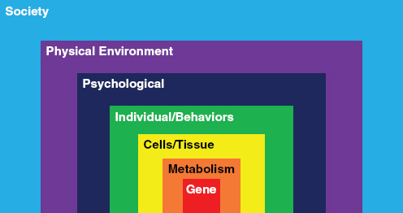
Not all mutation carriers will develop Cancer , they only have higher risk
Environment.
Life style.
Psychology.
Immune system.
Additional acquired mutations during life time.
…

Slide 9
Cancer according to NCI
Cancer is the name given to a collection of related diseases. In all types of cancer, some of the body’s cells begin to divide without stopping and spread into surrounding tissues.
Each person’s cancer has a unique combination of genetic changes. As the cancer continues to grow, additional changes will occur. Even within the same tumor, different cells may have different genetic changes.
Genetic changes that cause cancer can be inherited from our parents. They can also arise during a person’s lifetime as a result of errors that occur as cells divide or because of damage to DNA caused by certain environmental exposures.

Slide 10
Genetic alterations related to Cancer
Genes mutations.
Chromosomal aberrations.
Methylation – Histone modification – micro RNA (Epigenetic)

Slide 11
CNV: Copy Number Variation (deletion or amplification more than 50b.
SNP: Single Nucleotide Polymorphism.
INDEL: Insertion and/or Deletion nucleotides into genomic DNA less than I kb.
Hotspots: regions in DNA where gene mutations are significantly more likely to arise.
Fusion Genes: A fusion gene is a hybrid gene formed from two previously separate genes. It can occur as a result of: translocation, interstitial deletion, insertion or chromosomal inversion.

Slide 12
Mutated Genes related to Cancer
Some mutations activate the continuous production of cell cycle regulators (Cyclins/CDKs) and consequently lead to uncontrolled cell proliferation (Cancer). Oncogenes. (derived from Wild Type Proto-Oncogenes)
Some mutations inactivate the mechanisms that prevent the cells with damaged DNA from reaching mitosis by inhibiting the production of Cyclins/CDKs and consequently lead to uncontrolled cell proliferation (Cancer). Tumor suppressor genes.

Slide 13
Oncogenes
Tumor suppressor genes
Ras Family.
EGFR (HER1).
HER2 (ERBB2).
HER2, HER4.
BRAF.
Myc Family.
Fusion genes BCR-ABL, ALK-EML4,ROS1
…….
TP53 17p13.1
RB1 13q14.2
BRCA1 17q21.31
BRCA2 13q13.1
APC 5q22.2
PTEN 10q23.31
CDKN2A (P16) 9p21.3
……

Slide 14
Genetic testing in Cancer
Risk assessment (in Hereditary and Familial Cancer ).
Diagnosis.
Classification and Subtyping.
Treatment selection. (Pharmacogenetics, Targeted Therapy...).
Response prediction.
Response monitoring.
Prognosis.
Research.

Slide 15
Genetic Testing in Cancer
Karyotyping : overview study of tumor chromosomes for : Aneuploidy, Major translocation, deletion, inversion, amplification .. on living cells.
FISH: Targeted study for : Aneuploidy, Major and hidden translocation, microdeletion, inversion, fusion genes, amplification ..on living and fixed cells (FFPE).

Slide 16
Genetic testing in Cancer
The average cost of genetic testing for one gene is about 200 - 300 USD.
E.g. genetic testing for CRC : KRAS, NRAS, BRAF, PIK3CA, MSI costs around 1200 USD.

Slide 17
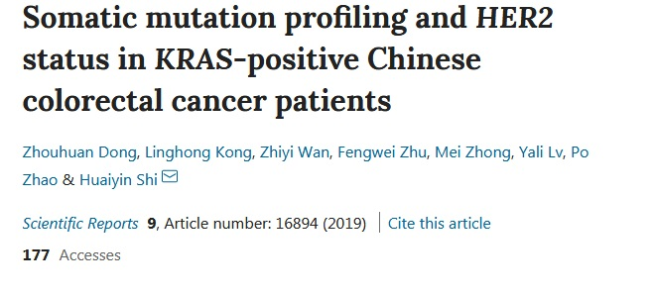

Slide 18
Tumor Gene Profiling
The determination of the unique combination of genetic changes in one tumor.
The main Goal is : More effective and Less toxic treatment.

Slide 20
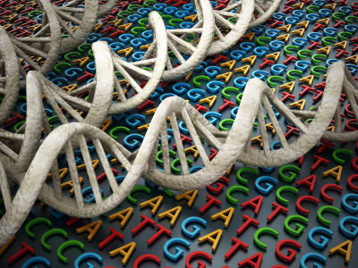
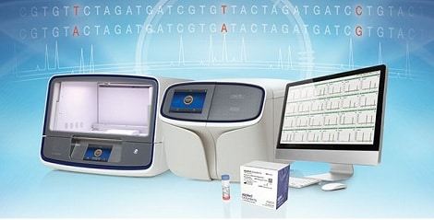
Tumor Gene Profiling
NGS ERA

Slide 21
NGS
Massively, parallel, deep, fast, relatively low cost, DNA sequencing.

Slide 22
Next Generation Sequencing
Next Generation Sequencing (NGS) is a powerful platform that has enabled the sequencing of thousands to millions of DNA molecules simultaneously.
This powerful tool is revolutionizing fields such as personalized medicine, genetic diseases, and clinical diagnostics by offering a high throughput option with the capability to sequence multiple individuals at the same time.
NGS can sequence a whole human genome in less than a day .
The Cancer Genome Atlas (TCGA) used NGS to map hundreds of cancer genes

Slide 26
WGS: Whole Genome Sequencing.
WES: Whole Exome Sequencing
Whole Transcriptome Sequencing : Whole RNA Sequencing.
Targeted sequencing : Detects known and novel variants in selected sets of genes or genomic regions (NGS Panels) for DNA and/or RNA.

Slide 27
NGS Oncology Panels
Solid tumors panels.
Leukemia panels.
Full length Gene sequencing. (BRCA1/2).
cfDNA Panels.
And much more …

Slide 28
Oncomine™ Focus Assay
The Oncomine™ Focus Assay is a targeted multi-biomarker next-generation sequencing (NGS) assay that enables the simultaneous detection of hundreds variants across 52 genes relevant to solid tumors. This assays allows concurrent analysis of:
DNA and RNA to simultaneously detect multiple types of variants, including Hotspots, single nucleotide variants (SNVs), indels, copy number variants (CNVs) and gene fusions, in a single workflow. Designed for translational and clinical research.
this assay includes solid tumor genes targeted by on-market oncology drugs and published evidence.

Slide 29
Oncomine™ Focus Assay – Gene List

Slide 30
Oncomine™ Comprehensive Assay v3
The Oncomine™ Comprehensive Assay v3 contains targeted, multi-biomarker panels
that enable simultaneous detection of hundreds of variants across 161 genes relevant to solid tumors. This assay allows concurrent analysis of DNA and RNA to simultaneously detect multiple types of variants, including hotspots, SNPs, insertions and deletions (INDELs), copy number variants (CNVs), and gene fusions, in a single workflow.

Slide 31
Oncomine™ Comprehensive Assay v3 - Gene List

Slide 32
Oncomine Childhood Cancer Research Assay
The Ion Torrent™ Oncomine™ Childhood Cancer Research Assay is a unique next-generation sequencing (NGS)– based tool designed for comprehensive genomic profiling of cancers affecting children and young adults. Since the driving genetic aberrations of these malignancies are different than those affecting adults, a specific and comprehensive panel is needed to advance research. Our panel is targeted to drive the future of precision medicine in pediatric oncology.
203 unique genes, including thousands of fusion drivers and comprehensive mutation coverage

Slide 33
Oncomine Childhood Cancer Research Assay- Gene List

Slide 34
Oncomine Myeloid Research Assay
The Ion Torrent™ Oncomine™ Myeloid Research Assay is a comprehensive, targeted NGS assay designed to assist in the understanding of myeloid cancer.
Specifically, it interrogates all relevant DNA mutations and fusion transcripts associated with myeloid disorders in a single NGS run. Our panel comprises 40 key DNA target genes, 29 driver genes, and a broad fusion panel to cover all the major myeloid disorders associated with acute myeloid leukemia
(AML), myeloid dysplastic syndrome (MDS), myeloproliferative neoplasms (MPN), chronic myeloid leukemia (CML), chronic myelomonocytic leukemia (CMML), and juvenile myelomonocytic leukemia (JMML).

Slide 35
Oncomine Myeloid Research Assay – Gene List

Slide 36
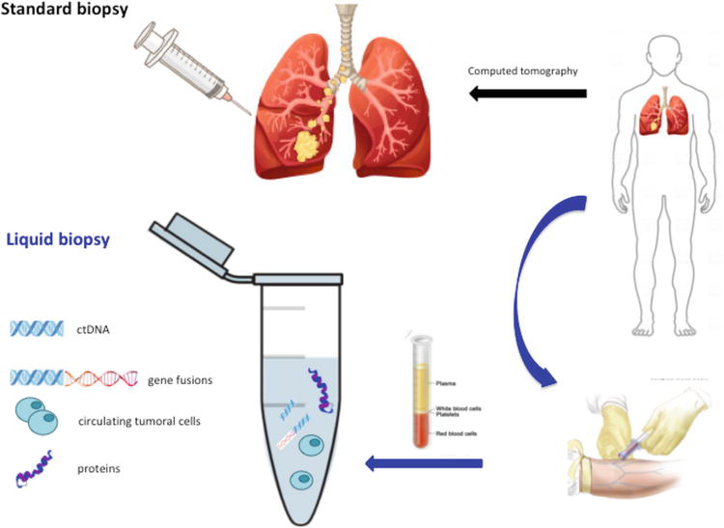
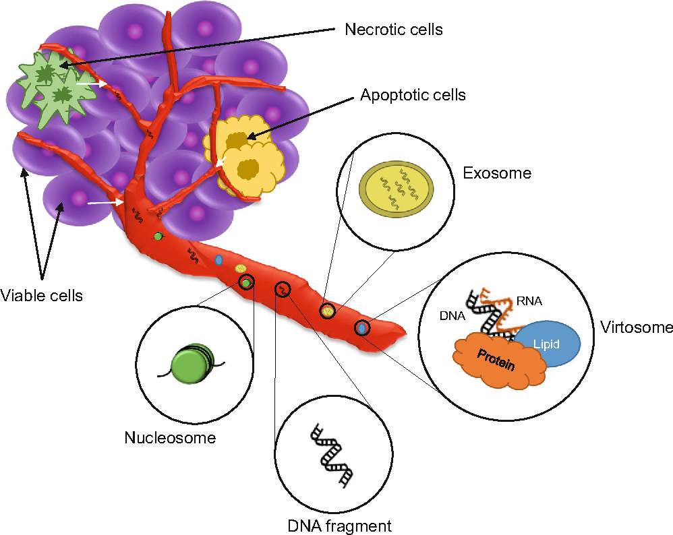
Liquid Biopsy - cfDNA Cell-Free DNA

Slide 37
Oncomine cfDNA Assays

Slide 38
Whole RNA Sequencing
Catalog complete sets of transcripts in the genome.
Understanding of disease at the transcript level.
Quantify changing expression levels of genes and transcripts during development.
Discover novel fusion transcripts.

Slide 40
شكرا mazenkenj@gmail.com

